Slide 1
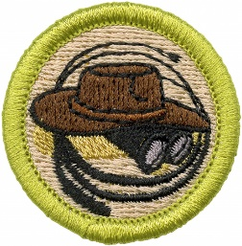
Exploration Merit Badge
Troop 344 and 9344
Pemberville, OH

Slide 2
This presentation was put together with the goal of an expedition to the Appalachian trail for the participants. It can easily be modified to reflect whatever expedition the youth working on the merit badge would prefer to do.

Slide 3
Exploration Merit Badge Requirements
General Knowledge. Do the following:
Define exploration and explain how it differs from adventure travel, trekking or hiking, tour-group trips, or recreational outdoor adventure trips.
Explain how approaches to exploration may differ if it occurs in the ocean, in space, in a jungle, or in a science lab in a city.
History of Exploration. Discuss with your counselor the history of exploration. Select a field of study with a history of exploration to illustrate the importance of exploration in the development of that field (for example, aerospace, oil industry, paleontology, oceanography, etc.).
Importance of Exploration. Explain to your counselor why it is important to explore. Discuss the following:
Why it is important for exploration to have a scientific basis
How explorers have aided in our understanding of our world
What you think it takes to be an explorer

Slide 4
Exploration Merit Badge Requirements
Real-Life Exploration. Do ONE of the following:
Learn about a living explorer. Create a short report or presentation (verbal, written, or multimedia slide presentation) on this individual's objectives and the achievements of one of the explorer's expeditions. Share what you have learned with your counselor and unit.
Learn about an actual scientific exploration expedition. Gather information about the mission objectives and the expedition's most interesting or important discoveries. Share what you have learned with your counselor and unit. Tell how the information gained from this expedition helped scientists answer important questions.
Learn about types of exploration that may take place in a laboratory or scientific research facility (medicine, biology, chemistry, physics, astronomy, etc.). Explain to your counselor how laboratory research and exploration are similar to field research and exploration.

Slide 5
Exploration Merit Badge Requirements
Exploration in Lab and Field. Do ONE of the following, and share what you learn with your counselor:
With your parent's permission and counselor's approval, visit either in person or via the internet an exploration sponsoring organization (such as The Explorers Club, National Geographic Society, Smithsonian Institution, Alpine Club, World Wildlife Fund, or similar organization). Find out what type(s) of exploration the organization supports.
With permission and approval, visit either in person or via the internet a science lab, astronomical observatory, medical research facility, or similar site. Learn what exploration is done in this facility.

Slide 6
Exploration Merit Badge Requirements
Expedition Planning. Discuss with your counselor each of the following steps for conducting a successful exploration activity. Explain the need for each step.
Identify the objectives (establish goals).
Plan the mission. Create an expedition agenda or schedule. List potential documents or permits needed.
Budget and plan for adequate financial resources. Estimate costs for travel, equipment, accommodations, meals, permits or licenses, and other expedition expenses.
Determine equipment and supplies required for personal and mission needs for the length of the expedition.
Determine communication and transportation needs. Plan how to keep in contact with your base or the outside world, and determine how you will communicate with each other on-site.
Establish safety and first aid procedures (including planning for medical evacuation). Identify the hazards that explorers could encounter on the expedition, and establish procedures to prevent or avoid those hazards.
Determine team selection. Identify who is essential for the expedition to be successful and what skills are required by the expedition leader.
Establish detailed recordkeeping (documentation) procedures. Plan the interpretation and sharing of information at the conclusion of the expedition.

Slide 7
Exploration Merit Badge Requirements
Prepare for an Expedition. With your parent's permission and counselor's approval, prepare for an actual expedition to an area you have not previously explored; the place may be nearby or far away. Do the following:
Make your preparations under the supervision of a trained expedition leader, expedition planner, or other qualified adult experienced in exploration (such as a school science teacher, museum representative, or qualified instructor).
Use the steps listed in requirement 6 to guide your preparations. List the items of equipment and supplies you will need. Discuss with your counselor why you chose each item and how it will be of value on the expedition. Determine who should go on the expedition.
Conduct a pre-expedition check, covering the steps in requirement 6, and share the results with your counselor. With your counselor, walk through the Sweet Sixteen of BSA Safety for your expedition. Ensure that all foreseeable hazards for your expedition are adequately addressed.

Slide 8
Exploration Merit Badge Requirements
Go on an Expedition. Complete the following:
With your parent's permission and under the supervision of your merit badge counselor or a counselor-approved qualified person, use the planning steps you learned in requirement 6 and the preparations you completed in requirement 7 to personally undertake an actual expedition to an area you have not previously explored.
Discuss with your counselor what is outdoor ethics and its role in exploration and enjoying the outdoors responsibly.
After you return, compile a report on the results of your expedition and how you accomplished your objective(s). Include a statement of the objectives, note your findings and observations, include photos, note any discoveries, report any problems or adverse events, and have a conclusion (whether you reached your objective or not). The post-expedition report must be at least one page and no more than three; one page can be photos, graphs, or figures.
Career Opportunities. Identify three career opportunities in exploration. Pick one and explain to your counselor how to prepare for such a career. Discuss what education and training are required, and why this profession might interest you.

Slide 9
Requirement 1
General Knowledge. Do the following:
Define exploration and explain how it differs from adventure travel, trekking or hiking, tour-group trips, or recreational outdoor adventure trips.
Explain how approaches to exploration may differ if it occurs in the ocean, in space, in a jungle, or in a science lab in a city.

Slide 10
Exploration
Exploration is the act of searching, with its goal being the discovery of information or resources.
It is the pursuit of knowledge, has a scientific basis, and information is collected and usually shared.
Adventure travel and recreational trips are generally more focused on pursuing a certain activity, or seeking a thrill.
These involve a predetermined effort to satisfy a personal need.

Slide 11
Requirement 1
General Knowledge. Do the following:
Define exploration and explain how it differs from adventure travel, trekking or hiking, tour-group trips, or recreational outdoor adventure trips.
Explain how approaches to exploration may differ if it occurs in the ocean, in space, in a jungle, or in a science lab in a city.

Slide 12
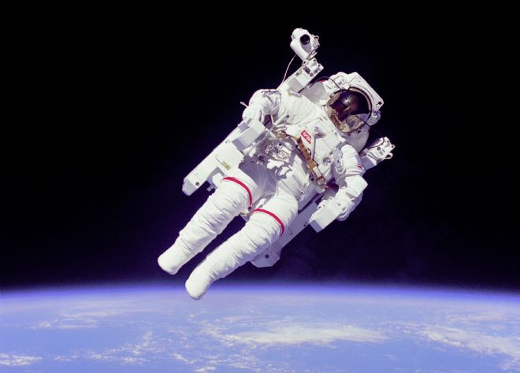
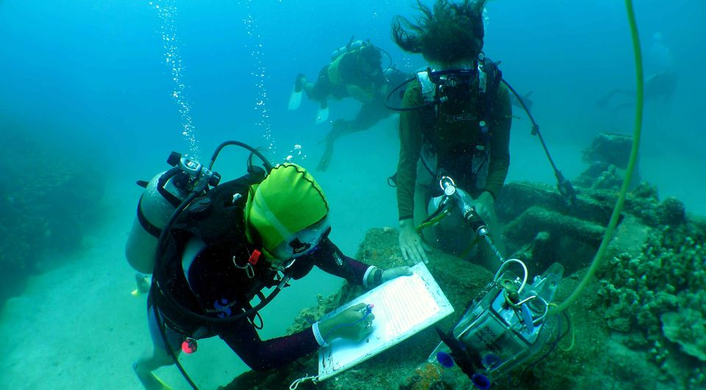
Approaches to Exploration
The frontier being explored may require differing approaches depending upon where it occurs.
Exploration in the ocean, in space, in a jungle, or in a science lab often require different technologies, processes, and techniques.

Slide 13
Requirement 2
History of Exploration. Discuss with your counselor the history of exploration. Select a field of study with a history of exploration to illustrate the importance of exploration in the development of that field (for example, aerospace, oil industry, paleontology, oceanography, etc.).

Slide 14
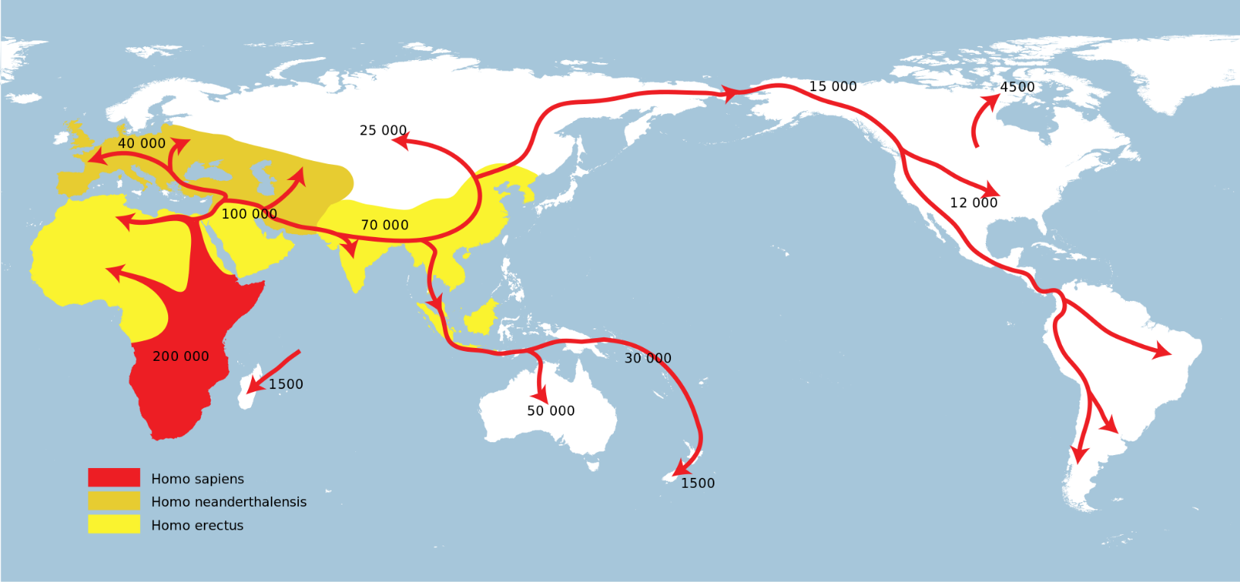
History of Exploration
Human beings have a natural tendency to explore.
This innate or instinctive urge to explore is one reason human ancestors left Africa in prehistorical times to eventually populate the rest of the planet.

Slide 15
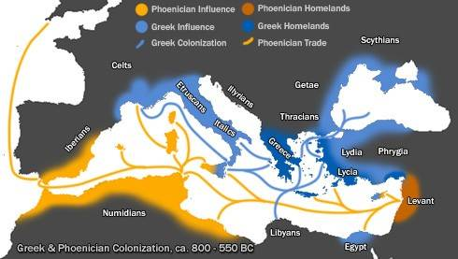
History of Exploration
The ancient Phoenicians, Greeks, and other Mediterranean civilizations explored at least as far as Britain and northern Africa.

Slide 16
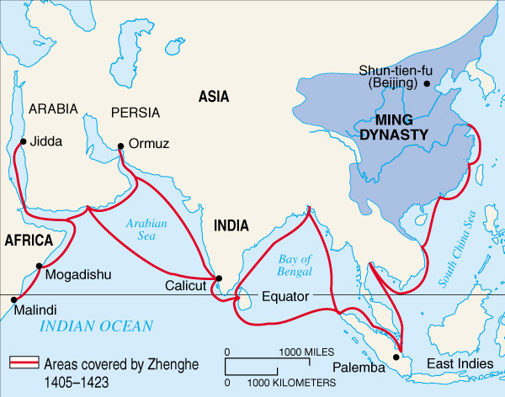
History of Exploration
More than 2,000 years ago Chinese voyagers began exploring the eastern parts of the Northern Hemisphere, including India, Southeast Asia, and Eastern Africa.

Slide 17
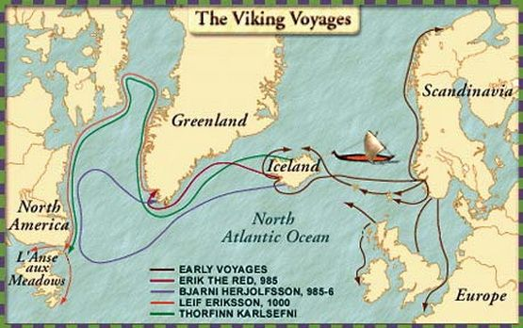
History of Exploration
Around 1,000 years ago the Vikings roamed throughout the western Northern Hemisphere and were the first Europeans to arrive in the New World.

Slide 18
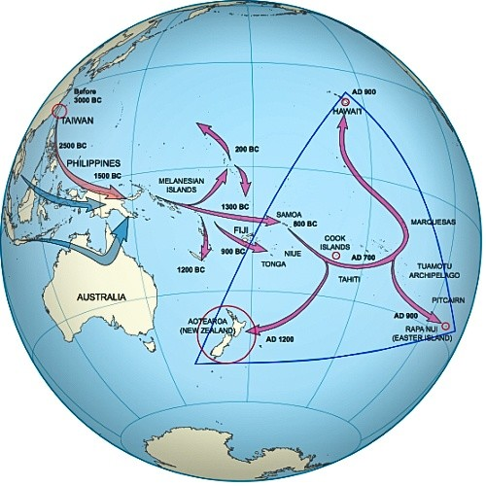
History of Exploration
Much of the Pacific was explored and its islands settled by seafaring Polynesians over a few thousand years lasting into the Middle Ages.

Slide 19
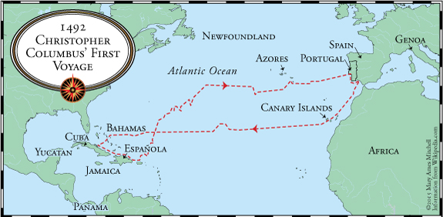
The Age of Discovery
In European history, a period of long-distance exploration began in the 15th century.
It began with the Portuguese discoveries of scattered islands in the Atlantic Ocean.
It included the discovery of the Americas by Christopher Columbus in 1492.

Slide 20
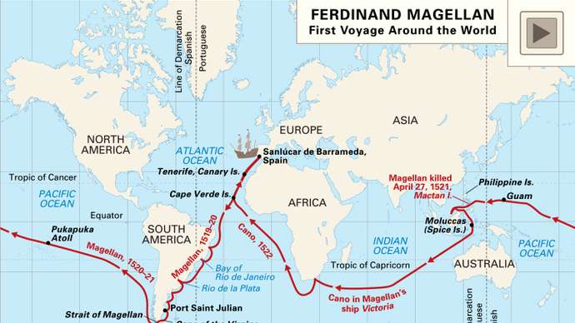
The Age of Discovery
It continued into the 17th and 18th centuries with European naval expeditions crossing the Atlantic and later the Pacific Ocean.
During this time, Europeans explored large areas of the Americas, Africa, Asia, and the islands of the tropical Pacific.

Slide 21
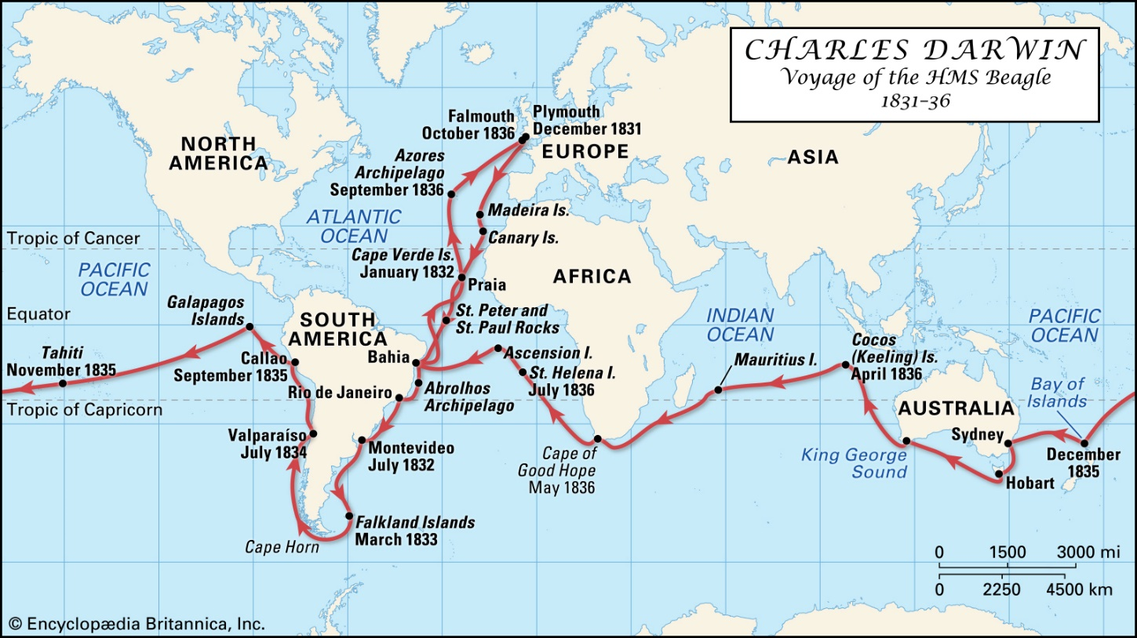
The Age of Discovery
After this age, further explorations brought knowledge from the voyage of Charles Darwin as well as regions of the North and South Poles.

Slide 22
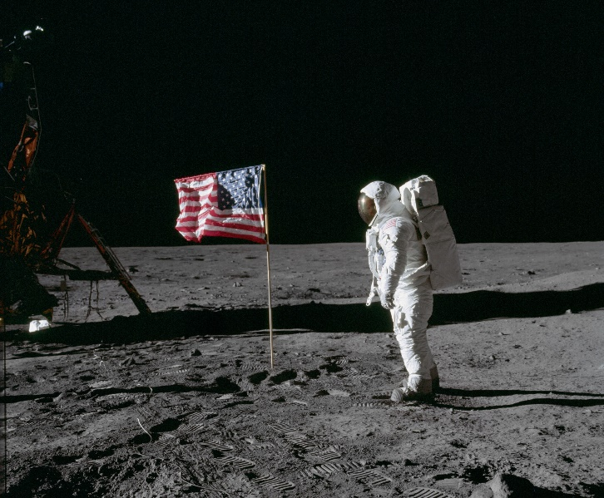
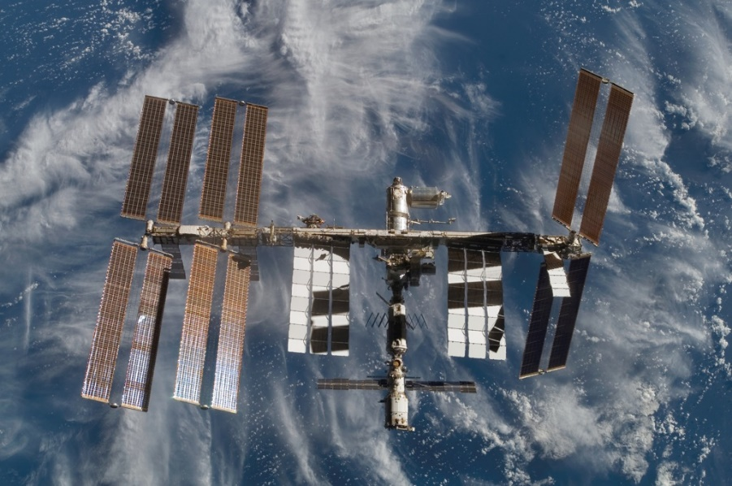
Modern Exploration
The history of exploration up until the early 20th century focused largely on geographical description.
Then came the explorations of the Space Age made possible by the development of rocket technology during World War II.

Slide 23
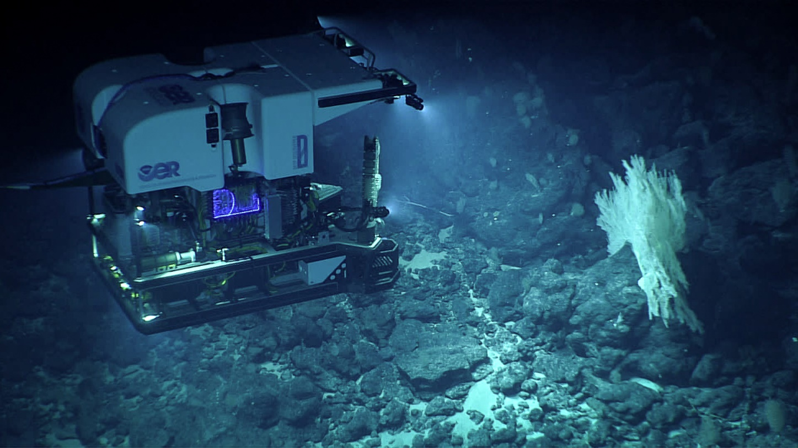
Modern Exploration
Today, explores are expanding on these earlier ventures and are also exploring new frontiers like the deep ocean and molecular biology.

Slide 24
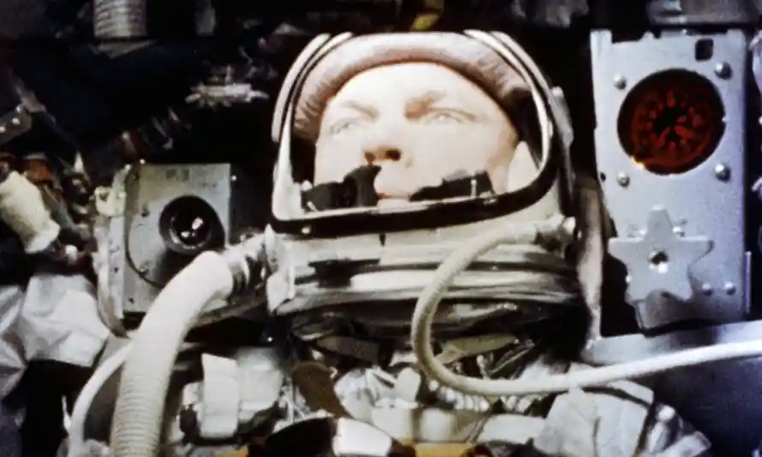
Importance of Exploration to the Aerospace Program
Each time we engage in exploration and press the limits of human endurance and technological capability a bit further, remarkable benefits are returned to our society in terms of new knowledge, advanced capabilities, novel industries, and inspiration to press even further.
The following brief timeline illustrates the importance of exploration in the development of the Aerospace program.

Slide 25
Brief Timeline of Aerospace Exploration
March 16, 1926: Robert Goddard, sometimes referred to as the "Father of Modern Rocketry," launches the first successful liquid-fueled rocket.
July 17, 1929: Robert Goddard launches a rocket that carries with it the first set of scientific tools — a barometer and a camera — in Auburn, Mass. The launch was Goddard's fourth.
Oct. 3, 1942: Germany successfully test launches the first ballistic missile, the A4, more commonly known as the V-2, and later uses it near the end of European combat in World War II.
Oct. 4, 1957: A modified R-7 two-stage ICBM launches the satellite Sputnik 1 from Tyuratam. The Space Race between the Soviet Union and the United States begins.

Slide 26
Brief Timeline of Aerospace Exploration
Oct. 7, 1958: NASA publicly announces NASA's manned spaceflight program along with the formation of the Space Task Group, a panel of scientist and engineers from space-policy organizations absorbed by NASA. The announcement came just six days after NASA was founded.
Jan. 2, 1959: The U.S.S.R. launches Luna 1, which misses the moon but becomes the first artificial object to leave Earth orbit.
Aug. 7, 1959: NASA's Explorer 6 launches and provides the first photographs of the Earth from space.
April 12, 1961: Yuri Gagarin becomes the first man in space with a 108-minute flight on Vostok 1 in which he completed one orbit.

Slide 27
Brief Timeline of Aerospace Exploration
May 25, 1961: In a speech before Congress, President John Kennedy announces that an American will land on the moon and be returned safely to Earth before the end of the decade.
Feb. 20, 1962: John Glenn makes the first U.S. manned orbital flight aboard Mercury 6.
Aug. 27, 1962: Mariner 2 launches and eventually performs the first successful interplanetary flyby when it passes by Venus.
July 14, 1965: Mariner 4 executes the first successful Mars flyby.
July 20, 1969: Six years after U.S. President John F. Kennedy's assassination, the Apollo 11 crew lands on the Moon, fulfilling his promise to put an American there by the end of the decade and return him safely to Earth.

Slide 28
Brief Timeline of Aerospace Exploration
Nov. 13, 1971: The Mariner 9 probe became the first craft to orbit another world - Mars.
March 3, 1972: Pioneer 10, the first spacecraft to leave the solar system, launches from Cape Kennedy, Fla.
Dec. 19, 1972: Apollo 17, the last mission to the moon, returns to Earth.
May 14, 1973: A Saturn V rocket launches Skylab, the United States' first space station.
March 29, 1974: Mariner 10 becomes the first spacecraft to fly by Mercury.
Nov. 13, 1971: Mariner 9 becomes the first spacecraft to orbit Mars and provides the first complete map of the planet's surface.
July 20, 1976: The U.S. Viking 1 lands on Mars, becoming the first successful Mars lander.

Slide 29
Brief Timeline of Aerospace Exploration
April 12, 1981: Space Shuttle Columbia lifts off from Cape Canaveral, beginning the first space mission for NASA's new astronaut transportation system.
April 25, 1990: The Space Shuttle Discovery releases the Hubble Space Telescope into Earth orbit.
July 23, 1999: The Chandra X-ray observatory, NASA's flagship mission for X-ray astronomy, launches aboard the Space Shuttle Columbia.
Nov. 2, 2000: First resident crew to occupy the International Space Station.
Jan. 4, 2004: The first Mars Exploration Rover, Spirit, lands on Mars. Its twin, Opportunity lands Jan. 25.

Slide 30
Brief Timeline of Aerospace Exploration
July 1, 2004: Cassini-Huygens becomes the first spacecraft to orbit Saturn.
Jan. 14, 2005: Huygens probe of the Cassini-Huygens spacecraft is the first spacecraft to land on the moon of a planet other than Earth (Saturn's moon Titan).
June 13, 2010: The Hayabusa from Japan is the first spacecraft to return to Earth with samples from an asteroid.
November 12, 2014: Philae from the European Space Agency is the first spacecraft to land on a comet.
July 14, 2015: New Horizons is the first spacecraft to fly by Pluto and return detailed photographs.
December 21, 2015: The Falcon 9 from Space X is the first rocket stage to return to its launch site.

Slide 31
Requirement 3
Importance of Exploration. Explain to your counselor why it is important to explore. Discuss the following:
Why it is important for exploration to have a scientific basis
How explorers have aided in our understanding of our world
What you think it takes to be an explorer

Slide 32
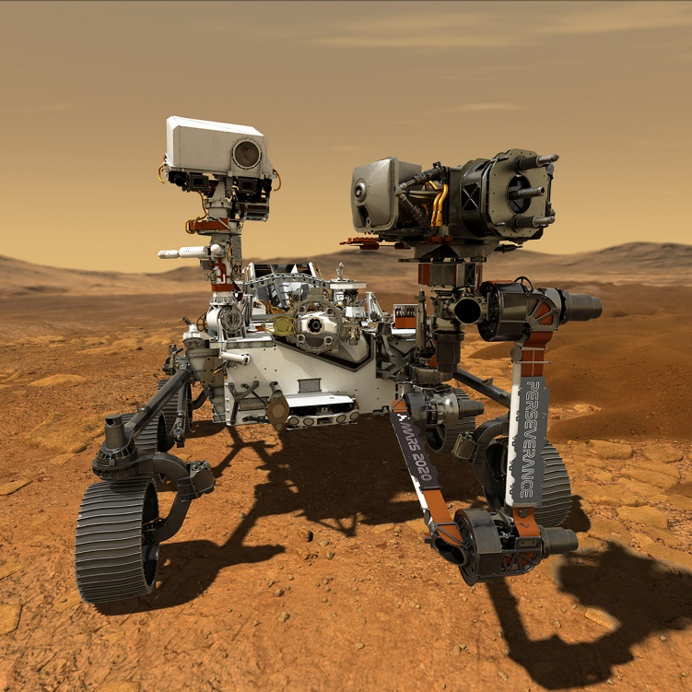
Scientific Basis of Exploration
Exploration has a scientific basis so that information can be collected and shared to contribute to scientific knowledge.
We need exploration to spur medical discoveries that help people live healthier lives, to seek ways of being more energy efficient, to protect our planet’s resources, to better understand Earth’s oceans and atmosphere, and to learn about worlds other than our own.

Slide 33
Benefits of Exploration
10 Everyday Spinoffs from NASA
Water Filter - NASA created the ion purification technology for Apollo. This spinoff created a multimillion dollar industry producing filters for pools, fountains, and drinking water.
Air Purifier - NASA developed an air purifier for astronauts to grow crops in space. Now it’s used by companies like Whole Foods to help preserve food and by hospitals to make their air sanitary. They are used in hotels and homes as well.
Memory Foam - Originally created for more comfortable airline seating, this technology has created a huge industry. The primary use is for mattresses and orthopedic seating.
Computer Mouse - NASA invested money in a study that led to the creation of the computer mouse.
Cell Phone Camera - 1 out of 3 cell phone cameras use technology developed for space cameras.
Long Distance Communication - NASA’s developments have enhanced the use of satellites for uses like clear long distance communication.
Ear Thermometer - NASA collaborated with Diatek to develop an 8 ounce aural thermometer which uses the same technology used to measure the temperature of stars and planets.
Breast Cancer Detection - Originally conceived for the use in terrestrial remote sensing applications, NASA’s Hierarchical Segmentation (HSEG) software is used to enhance imaging in mammograms and X-rays.
Fire Fighter Gear - Much of the fire fighter gear used in the U.S. is based on NASA’s development of lightweight, fire resistant clothing.
Airplane Winglets - In 1977, NASA, Boeing, and the U.S. Air Force created winglets to reduce drag during flight. By 2010, the technology had saved 2 billion gallons of jet fuel. That’s a savings of $4 billion and 21.5 million tons of carbon dioxide emissions.

Slide 34
Requirement 3
Importance of Exploration. Explain to your counselor why it is important to explore. Discuss the following:
Why it is important for exploration to have a scientific basis
How explorers have aided in our understanding of our world
What you think it takes to be an explorer

Slide 35
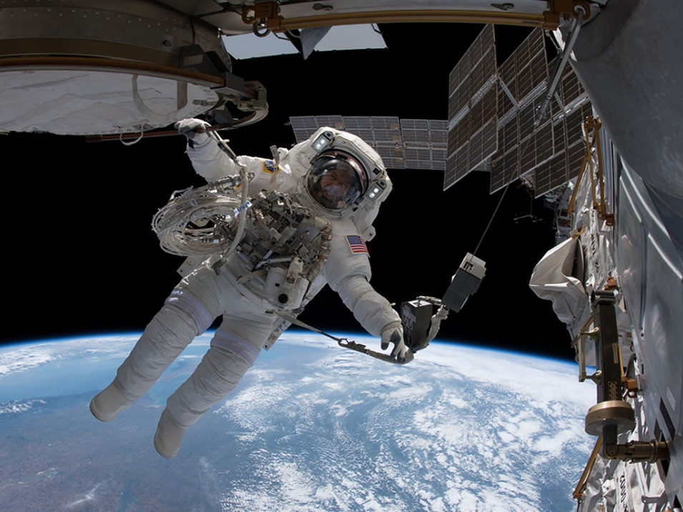
Space Exploration
Space explorers discover new celestial bodies – including stars, planets, moons, asteroids, and comets – and observe the known ones.
New technologies for human spaceflight and robotic probes are constantly expanding the possibilities for the physical exploration of space.

Slide 36
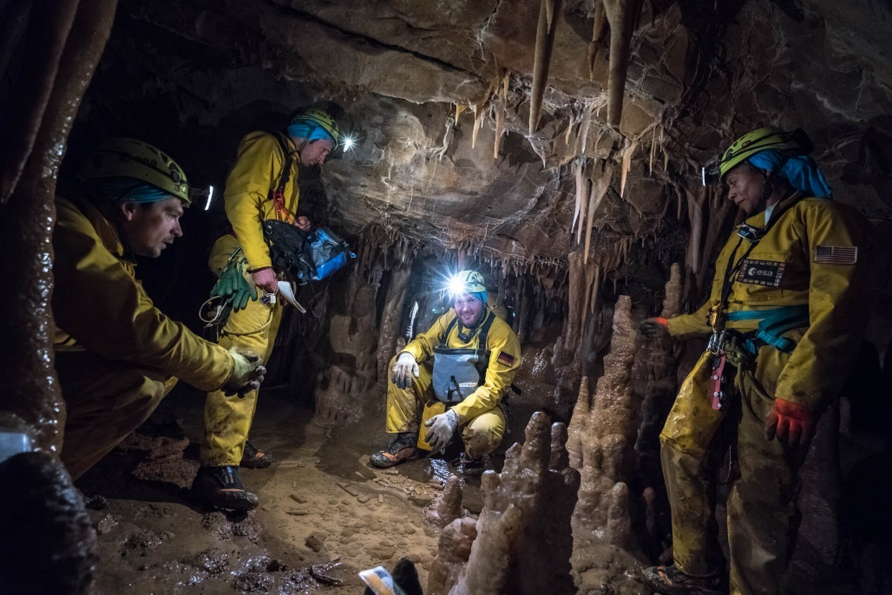
Subterranean Exploration
Below ground discoveries of new animals and microscopic species are helping us understand the complex interactions of living things underground and how species adapt to lower levels of light and oxygen.
Physical exploration is extending our knowledge of large underground cave systems.

Slide 37
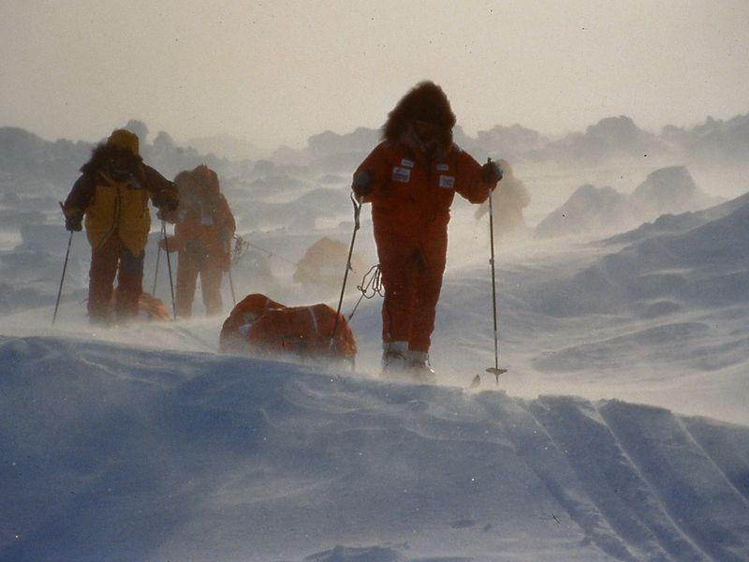
Polar Exploration
Environmental science studies are being done in both polar regions.
Permanent international research stations in Antarctica study marine life, environmental changes, the effects of ocean currents, and other topics and sciences including weather, geology, and paleontology.

Slide 38
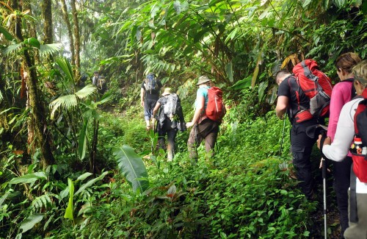
Tropical Exploration
Up to two-thirds of all known plants and animals live in the lush rain forests of the tropics.
New discoveries are constantly added to the millions of species that are known to live in rain forests.
Increasing deforestation poses problems that require significant research and exploration to understand the effects of the destruction and to find practical solutions to balance or prevent such loss.
Bioprospecting is the search for plant and animal species from which valuable new products and medicines can be obtained.

Slide 39
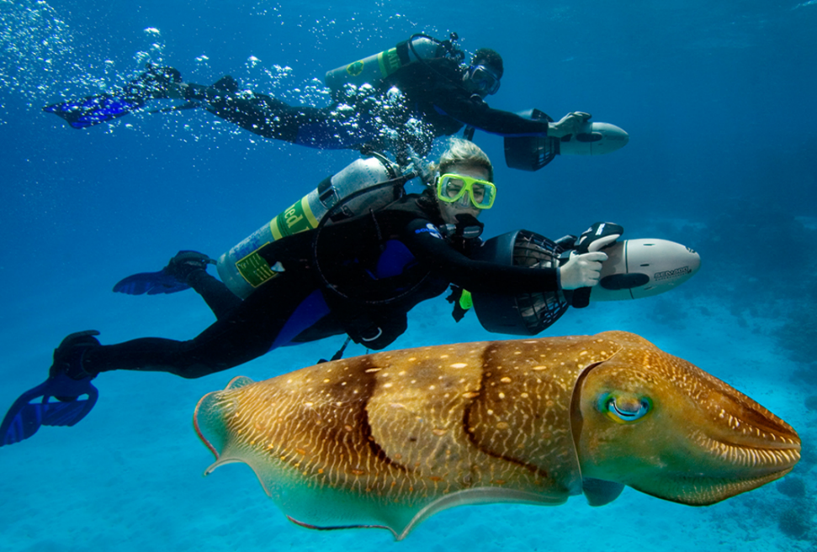
Marine Exploration
Some ocean explorers search beneath the waves to locate and identify historic shipwrecks.
Other marine researchers seek sustainable fishing and food sources, track the environmental effects of ocean pollution, study the effects of ocean currents on climate, seek to understand and protect coral reefs, or do geological research on the seafloor.

Slide 40
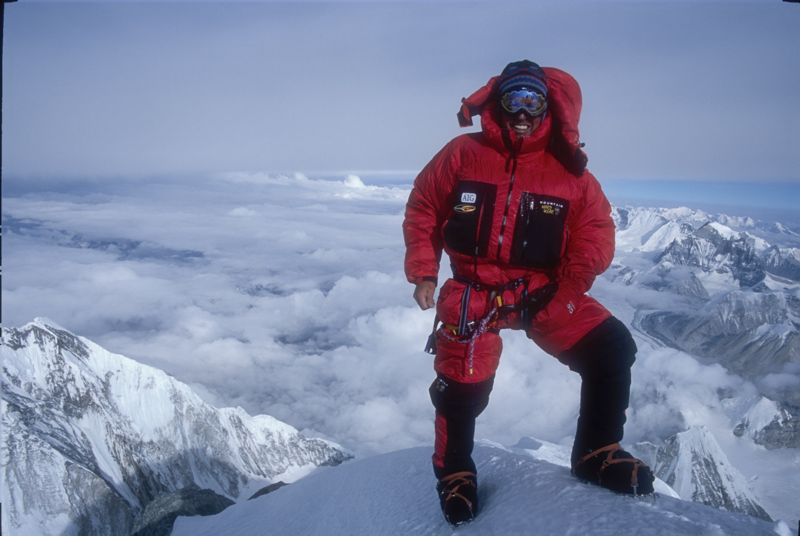
High Altitude Exploration
High-altitude explores may identify and analyze mineral resources in the mountains or weather patterns and their effects on environment.
Researchers study the effects of thin air on the human body and brain.

Slide 41
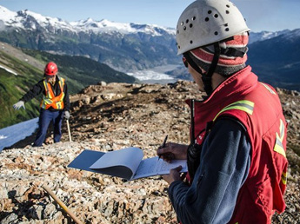
Geological Exploration
Early geological explores were mostly interested in describing geographic features and searching for riches.
The emphasis now is on greater understanding of our world and more efficient, sustainable use of natural resources.
Oil and mineral exploration continues to be of vital importance.

Slide 42
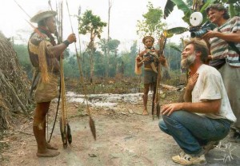
Anthropology and Exploration
Anthropology is the study of humans, both ancient and modern.
Anthropology connects to the social and biological sciences and commonly is divided into broad categories of cultural anthropology, biological or physical anthropology, archaeology, and linguistics.
Cultural anthropologists examine social patterns and how people live together in particular places, and study differences and similarities of race, class, gender, and nationality.
This type of research and exploration often involves living among the group being studied and observing their practices in everyday life.

Slide 43
Requirement 3
Importance of Exploration. Explain to your counselor why it is important to explore. Discuss the following:
Why it is important for exploration to have a scientific basis
How explorers have aided in our understanding of our world
What you think it takes to be an explorer

Slide 44
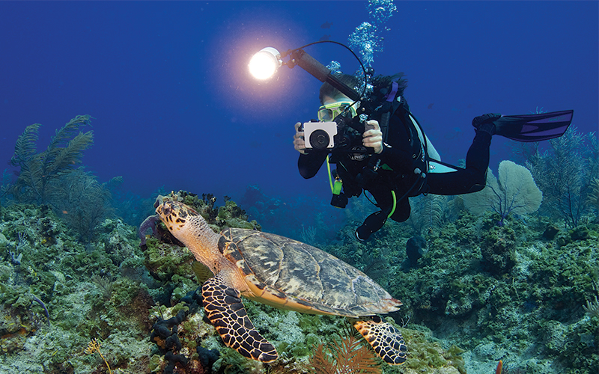
What Does It Take to Be an Explorer
Exploration is incredibly diverse with many different areas.
However, explorers seem to have certain traits in common:
Inquisitiveness; continuously asking questions and seeking answers.
Passion about the subjects of their exploration and driven by a desire to learn, understand, explain, and share their findings.
Persistent in their quest; driven sometimes to go against conventional thought while standing by their convictions.

Slide 45
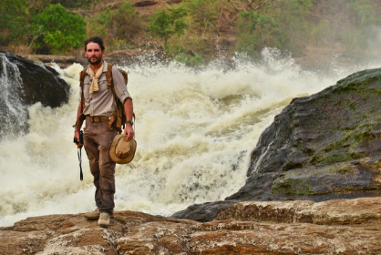
What Does It Take to Be an Explorer
Explorers are also:
leaders.
problem solvers.
informed, curious, and capable individuals who are committed to making the world a better place.
have a sense of responsibility and respect for other people, cultures, and the natural world.
empowered to make a difference, pursue bold ideas, and persist in the face of challenges.
observe, document, and engage with the world around them.
tell stories that inspire others.
create and foster a global community committed to a sustainable future.
committed to supporting diversity, equity, and inclusion in their respective fields.

Slide 46
Requirement 4
Real-Life Exploration. Do ONE of the following:
Learn about a living explorer. Create a short report or presentation (verbal, written, or multimedia slide presentation) on this individual's objectives and the achievements of one of the explorer's expeditions. Share what you have learned with your counselor and unit.
Learn about an actual scientific exploration expedition. Gather information about the mission objectives and the expedition's most interesting or important discoveries. Share what you have learned with your counselor and unit. Tell how the information gained from this expedition helped scientists answer important questions.
Learn about types of exploration that may take place in a laboratory or scientific research facility (medicine, biology, chemistry, physics, astronomy, etc.). Explain to your counselor how laboratory research and exploration are similar to field research and exploration.

Slide 47
Living Explorers

Slide 48
Living Explorers

Slide 49
Living Explorers

Slide 50
Living Explorers

Slide 51
Living Explorers

Slide 52
Living Explorers

Slide 53
Living Explorers

Slide 54
Living Explorers

Slide 55
Living Explorers

Slide 56
Living Explorers

Slide 57
Living Explorers

Slide 58
Requirement 4
Real-Life Exploration. Do ONE of the following:
Learn about a living explorer. Create a short report or presentation (verbal, written, or multimedia slide presentation) on this individual's objectives and the achievements of one of the explorer's expeditions. Share what you have learned with your counselor and unit.
Learn about an actual scientific exploration expedition. Gather information about the mission objectives and the expedition's most interesting or important discoveries. Share what you have learned with your counselor and unit. Tell how the information gained from this expedition helped scientists answer important questions.
Learn about types of exploration that may take place in a laboratory or scientific research facility (medicine, biology, chemistry, physics, astronomy, etc.). Explain to your counselor how laboratory research and exploration are similar to field research and exploration.

Slide 59
Famous Scientific Exploration Expeditions
With your parents permission, use the internet to learn about an actual scientific exploration expedition.
Gather information about the mission objectives and the expedition's most interesting or important discoveries.
Tell how the information gained from this expedition helped scientists answer important questions.
Some examples of famous scientific exploration expeditions include:
Captain James Cook and the Endeavor, 1768-1771.
Lewis and Clark expedition, 1803-1806.
Charles Darwin and the voyage of the Beagle, 1831-1836.
The HMS Challenger Expedition, 1873-1876.
Amundson expedition to the South Pole, 1912.
Thor Heyerdahl and the Kon-Tiki expedition, 1947.

Slide 60
Requirement 4
Real-Life Exploration. Do ONE of the following:
Learn about a living explorer. Create a short report or presentation (verbal, written, or multimedia slide presentation) on this individual's objectives and the achievements of one of the explorer's expeditions. Share what you have learned with your counselor and unit.
Learn about an actual scientific exploration expedition. Gather information about the mission objectives and the expedition's most interesting or important discoveries. Share what you have learned with your counselor and unit. Tell how the information gained from this expedition helped scientists answer important questions.
Learn about types of exploration that may take place in a laboratory or scientific research facility (medicine, biology, chemistry, physics, astronomy, etc.). Explain to your counselor how laboratory research and exploration are similar to field research and exploration.

Slide 61
Exploration in Labs
The main purpose of research and exploration, whether it is in a laboratory or in the field, is discovering information and contributing to scientific knowledge.
One example of exploration in the lab is Molecular Exploration.
Molecular science is a rapidly growing area of scientific discovery.
Molecular exploration has led to the production of vaccines, techniques for treating illnesses, detecting diseases, and in the field of forensic science to help solve crimes.

Slide 62
Requirement 5
Exploration in Lab and Field. Do ONE of the following, and share what you learn with your counselor:
With your parent's permission and counselor's approval, visit either in person or via the internet an exploration sponsoring organization (such as The Explorers Club, National Geographic Society, Smithsonian Institution, Alpine Club, World Wildlife Fund, or similar organization). Find out what type(s) of exploration the organization supports.
With permission and approval, visit either in person or via the internet a science lab, astronomical observatory, medical research facility, or similar site. Learn what exploration is done in this facility.

Slide 63
Exploration Sponsoring Organizations
The following links will connect you to the websites of exploration sponsoring organizations.
The Explorer’s Club
The National Geographic Society

Slide 64
Exploration Sponsoring Organizations
The following links will connect you to the websites of exploration sponsoring organizations.
Smithsonian Institution
The Alpine Club

Slide 65
Exploration Sponsoring Organizations
The following links will connect you to the websites of exploration sponsoring organizations.
World Wildlife Fund
NOAA Office of Ocean Exploration and Research

Slide 66
Exploration Sponsoring Organizations
The following links will connect you to the websites of exploration sponsoring organizations.
NASA
National Science Foundation

Slide 67
Requirement 5
Exploration in Lab and Field. Do ONE of the following, and share what you learn with your counselor:
With your parent's permission and counselor's approval, visit either in person or via the internet an exploration sponsoring organization (such as The Explorers Club, National Geographic Society, Smithsonian Institution, Alpine Club, World Wildlife Fund, or similar organization). Find out what type(s) of exploration the organization supports.
With permission and approval, visit either in person or via the internet a science lab, astronomical observatory, medical research facility, or similar site. Learn what exploration is done in this facility.

Slide 68
Research Facilities
Institute for Astronomy
Woods Hole Oceanographic Institute
Brookhaven National Laboratory

Slide 69
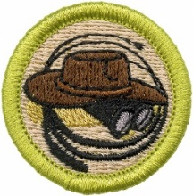
Requirement 6
Expedition Planning. Discuss with your counselor each of the following steps for conducting a successful exploration activity. Explain the need for each step.
Identify the objectives (establish goals).
Plan the mission. Create an expedition agenda or schedule. List potential documents or permits needed.
Budget and plan for adequate financial resources. Estimate costs for travel, equipment, accommodations, meals, permits or licenses, and other expedition expenses.
Determine equipment and supplies required for personal and mission needs for the length of the expedition.
Determine communication and transportation needs. Plan how to keep in contact with your base or the outside world, and determine how you will communicate with each other on-site.
Establish safety and first aid procedures (including planning for medical evacuation). Identify the hazards that explorers could encounter on the expedition, and establish procedures to prevent or avoid those hazards.
Determine team selection. Identify who is essential for the expedition to be successful and what skills are required by the expedition leader.
Establish detailed recordkeeping (documentation) procedures. Plan the interpretation and sharing of information at the conclusion of the expedition.

Slide 70
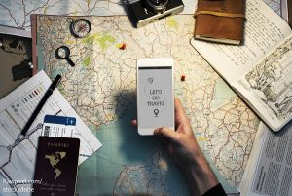
Expedition Planning
Develop a Concept
Longstanding interest or sudden curiosity.
Define concept further.
What is your objective?
What are you hoping to learn?
Do Your Research
To more fully understand what you’re trying to learn and why.
Determine best timing.
Geography and climate.
If the area is unfamiliar.
Find out about cultural issues and differences.
Find current info on local unrest.
Check on local laws and restrictions that might limit your project.
Determine resources at the site.

Slide 71
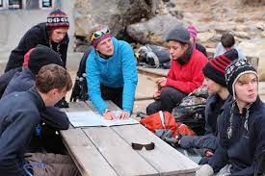
Expedition Planning
Select Your Team.
Unless your expedition is designed to be individual AND you are certain you have the adequate skills necessary.
Consider:
Skills.
Behavior and personality.
Team chemistry.
Keep in mind that expeditions can be stressful and how someone reacts under stress may affect your activities.
Get to know their personalities.
Try and spot any warning signs.
Everyone’s availability.

Slide 72
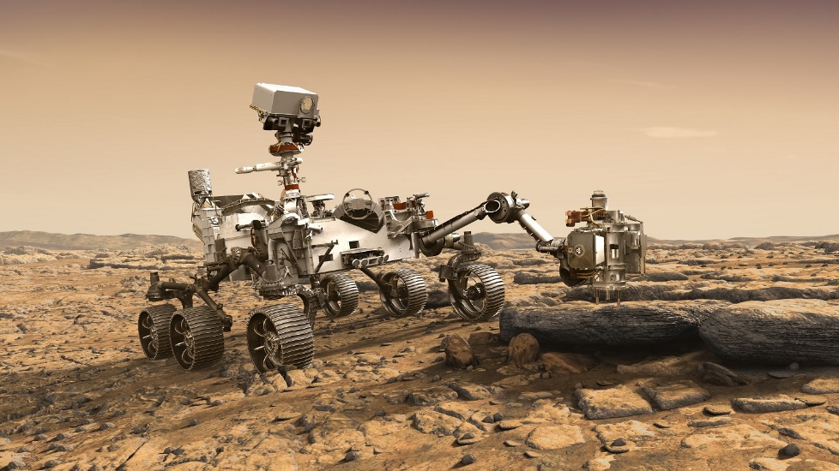
Expedition Planning
Create an Agenda
Serves as a guide during preparation.
Provides a frame-work for the activities planned.
Outlines what needs to be done after you return.
Helps organize your exploration.
ID areas where obstacles may arise.
Assist in dealing with unexpected delays.
Time for each step.
Assigns tasks as appropriate so the team shares in the work.
Helps shorten preparation and exploration times.
Share your agenda with someone not going on the expedition.

Slide 73
Expedition Planning
Secure Expedition Financing.
A rough budget.
Alternate sources of funding.
Gifts and Grants from organizations and individuals.

Slide 74
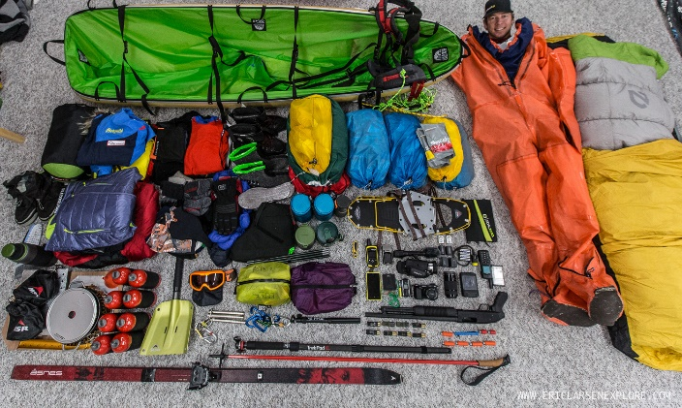
Expedition Planning
Gather Equipment and Supplies.
Equipment will vary due to:
Location.
Climate.
Season.
Altitude.
Number of people.
Discuss all equipment and supplies with your team.
All are in agreement.
All are in the know.
Equipment needs to be carefully chosen and calculated as to weight and volume limitations (how much you can carry).
Consider extra batteries, bulbs, digital camera and memory card, cords, and other essentials.
Plan to pack everything out.
BE PRACTICAL.

Slide 75
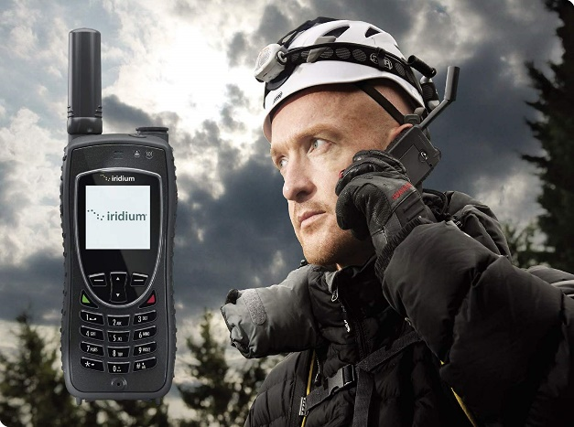
Expedition Planning
Make a Communication Plan.
For exploration in a remote area, communication equipment is essential.
Terrain is the major factor to be considered.
Simple cell phones work in urban areas and areas with clear lines of sight but remote areas may have sparse coverage.
Steep terrain can block cellular coverage.
Satellite phones and GPS have advantages but require triangulation.
They can be blocked by canyons and rain-forest canopies.
A mobile phone configured for the local mobile network is the most common and versatile communication tool.

Slide 76
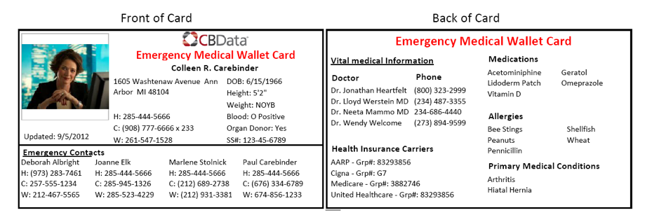
Expedition Planning
Establish Safety and First-Aid Procedures.
Make safety a priority.
Screen participants for medical conditions that could cause trouble later on.
Asthma, allergies, recent surgeries, etc.
All participants should have written clearance from a doctor (physical).
Vaccines updated.
Any expedition member with a medical condition should carry a medical history including any medications used.
Participants should obtain medical evacuation insurance if visiting remote areas.
Carry a SOAP Note to aid in evacuation (download copies).

Slide 77
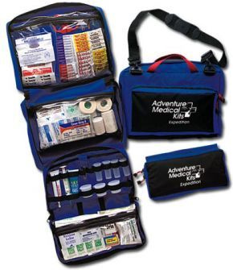
Expedition Planning
Establish Safety and First-Aid Procedures (continued).
All participants should have a Personal First Aid Kit.
Team Medical Kits must be practical, weigh as little as possible, and take up minimal space.
Download checklists for suggested supplies (both are found on the same form).

Slide 78
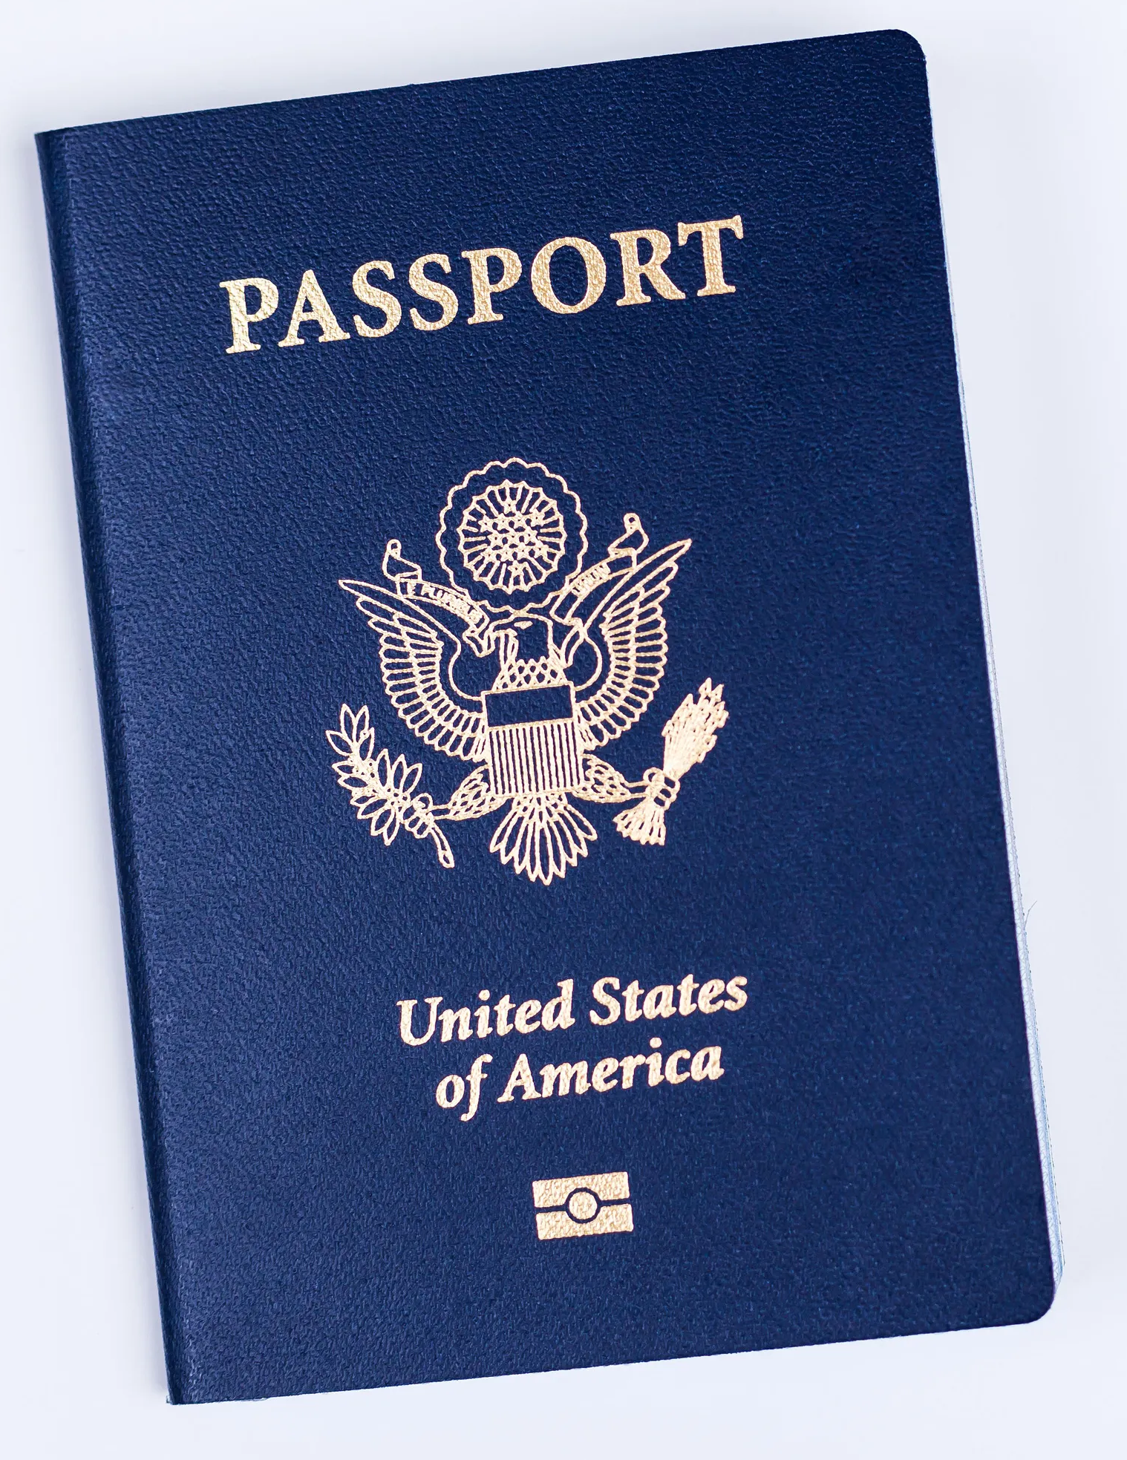
Expedition Planning
Obtain Necessary Documents.
All travelers must have valid identification for domestic or international travel.
Valid passports are necessary to travel outside of the United States.
If visas are required, they may take several weeks to obtain.
Make photocopies of passports, visas, and vaccination records in case of loss or theft.
Obtain any necessary permits to enter restricted areas.
Understand the Legal Considerations.
Travel and exploration always pose some risks.
All participants must be fully informed of risks and that they are voluntarily accepting these risks.

Slide 79
Expedition Planning
Establish Recordkeeping Procedures.
Keeping a personal journal is an excellent way to record your experiences and help you recall details later.
Use a waterproof journal or keep a small notebook in a Ziploc bag.
Other important documentation:
Supply lists to keep track of inventory and warn of possible shortages.
A list should be kept of medications used from the team medical kit to help resupply.
Keep a log of any individual who was give medication, along with the symptoms, date, and time.
Document any adverse events or problems that arise.
Helps provide an accurate account of the event in case of legal or insurance issues.

Slide 80
Requirement 7
Prepare for an Expedition. With your parent's permission and counselor's approval, prepare for an actual expedition to an area you have not previously explored; the place may be nearby or far away. Do the following:
Make your preparations under the supervision of a trained expedition leader, expedition planner, or other qualified adult experienced in exploration (such as a school science teacher, museum representative, or qualified instructor).
Use the steps listed in requirement 6 to guide your preparations. List the items of equipment and supplies you will need. Discuss with your counselor why you chose each item and how it will be of value on the expedition. Determine who should go on the expedition.
Conduct a pre-expedition check, covering the steps in requirement 6, and share the results with your counselor. With your counselor, walk through the Sweet Sixteen of BSA Safety for your expedition. Ensure that all foreseeable hazards for your expedition are adequately addressed.

Slide 81
Prepare for an Expedition
Appalachian Trail Expedition.
Download the Appalachian Trail Trip Itinerary
Download the Appalachian Trail Backpacking Guide
Read the book: The Unlikely Thru-Hiker: An Appalachian Trail Journey by Derick Lugo (optional but highly recommended)
Research the following (The Appalachian Trail Conservancy website is a great place to start):
History of the Appalachian Trail.
Construction of the Appalachian Trail.
Appalachian Trail maintenance.
Flora and fauna of the Appalachian Trail in Virginia.
Weather conditions of the Appalachian Trail in Virginia in July.
Follow the procedures for expedition planning.

Slide 82
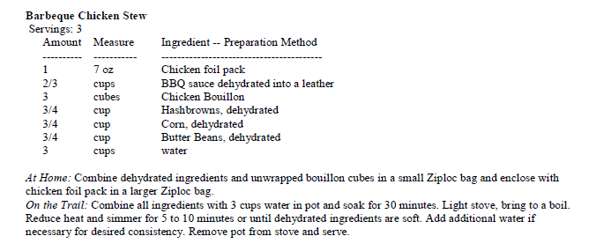
Equipment and Supplies
Download the Appalachian Trail Backpacking Guide.
Download the Backpacking Menu Planner.
Download Backpacking Recipes.

Slide 83
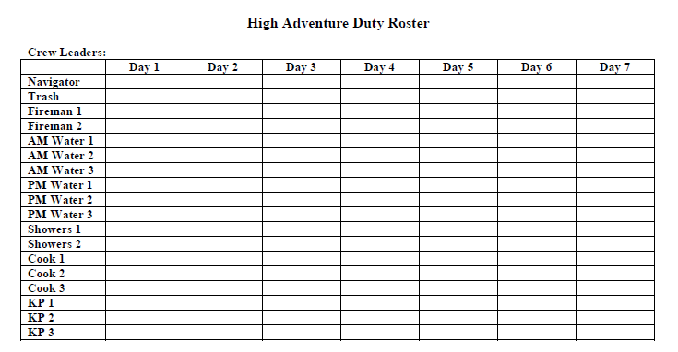
Team Members
As you assemble the team members, download the following for help in determining team member roles and expectations:
High Adventure Duty Roster.
Backpacking Etiquette.

Slide 84
Requirement 7
Prepare for an Expedition. With your parent's permission and counselor's approval, prepare for an actual expedition to an area you have not previously explored; the place may be nearby or far away. Do the following:
Make your preparations under the supervision of a trained expedition leader, expedition planner, or other qualified adult experienced in exploration (such as a school science teacher, museum representative, or qualified instructor).
Use the steps listed in requirement 6 to guide your preparations. List the items of equipment and supplies you will need. Discuss with your counselor why you chose each item and how it will be of value on the expedition. Determine who should go on the expedition.
Conduct a pre-expedition check, covering the steps in requirement 6, and share the results with your counselor. With your counselor, walk through the Sweet Sixteen of BSA Safety for your expedition. Ensure that all foreseeable hazards for your expedition are adequately addressed.

Slide 85
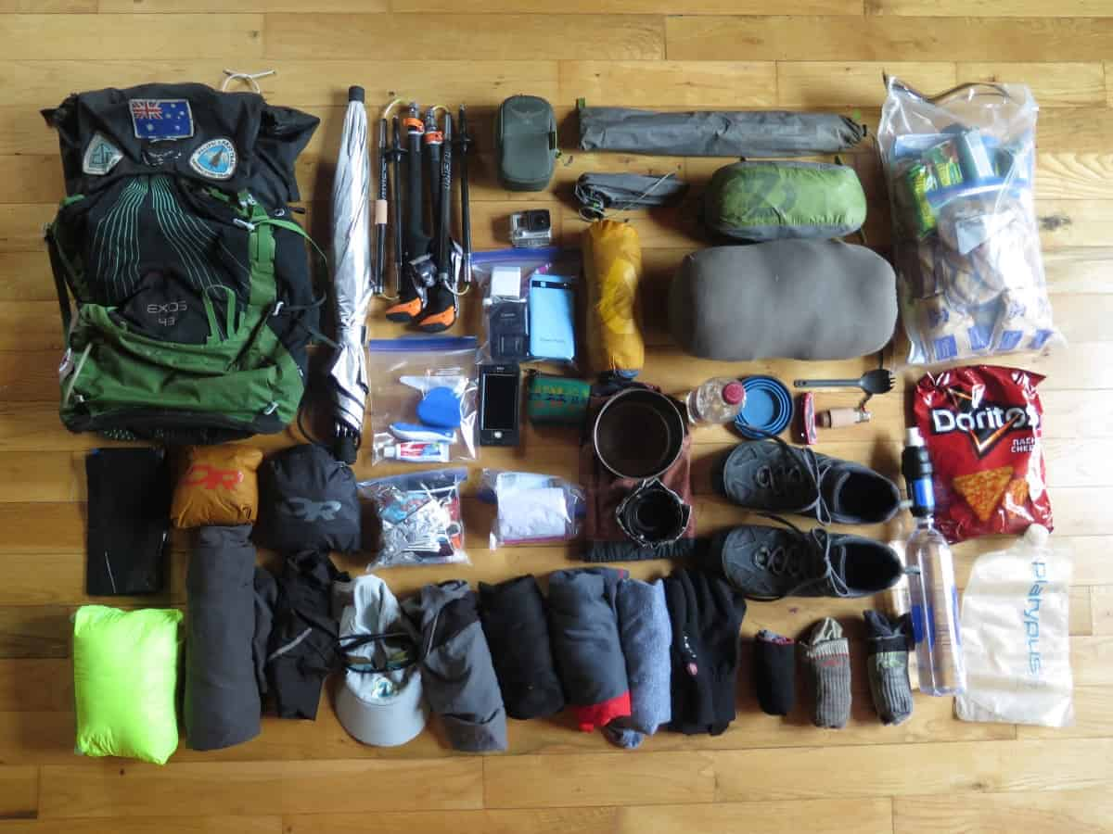
Pre-Expedition Check
Pre-shakedown hike meeting to review each participants packs/personal equipment, Troop equipment, food, and supplies.
Shakedown hike on the Zaleski Backpacking Trail.
Post-shakedown hike review
What works, doesn’t work, needs changed, etc.
Pre-expedition trip meeting to review each participants packs/personal equipment, Troop equipment, food, and supplies.

Slide 86
Sweet Sixteen of BSA Safety
QUALIFIED SUPERVISION
Every BSA activity should be supervised by a conscientious adult who understands and knowingly accepts responsibility for the well-being and safety of the children and youth in his or her care. The supervisor should be sufficiently trained, experienced, and skilled in the activity to be confident of his/her ability to lead and to teach the necessary skills and to respond effectively in the event of an emergency. Field knowledge of all applicable BSA standards and a commitment to implement and follow BSA policies and procedures are essential parts of the supervisor’s qualifications.
PHYSICAL FITNESS
For youth participants in any potentially strenuous activity, the supervisor should receive a complete health history from a health-care professional, parent, or guardian. Adult participants and youth involved in higher-risk activity (e.g., scuba) may require professional evaluation in addition to the health history. The supervisor should adjust all supervision, discipline, and protection to anticipate potential risks associated with individual health conditions. Neither youth nor adults should participate in activities for which they are unfit. To do so would place both the individual and others at risk.
BUDDY SYSTEM
The long history of the buddy system in Scouting has shown that it is always best to have at least one other person with you and aware at all times as to your circumstances and what you are doing in any outdoor or strenuous activity.
SAFE AREA OR COURSE
A key part of the supervisor’s responsibility is to know the area or course for the activity and to determine that it is well-suited and free of hazards.

Slide 87
Sweet Sixteen of BSA Safety
EQUIPMENT SELECTION AND MAINTENANCE
Most activity requires some specialized equipment. The equipment should be selected to suit the participant and the activity and to include appropriate safety and program features. The supervisor should also check equipment to determine that it is in good condition for the activity and is properly maintained while in use.
PERSONAL SAFETY EQUIPMENT
The supervisor must ensure that every participant has and uses the appropriate personal safety equipment. For example, activity afloat requires a life jacket properly worn by each participant; bikers, horseback riders, and whitewater kayakers need helmets for certain activities; skaters may need protective gear; and all need to be dressed for warmth and utility depending on the circumstances.
SAFETY PROCEDURES AND POLICIES
For most activities, there are common-sense procedures and standards that can greatly reduce the risk. These should be known and appreciated by all participants, and the supervisor must ensure compliance.
SKILL LEVEL LIMITS
There is a minimum skill level requirement for every activity, and the supervisor must identify and recognize this minimum skill level and be sure that no participants are put at risk by attempting an activity beyond their ability. A good example of skill levels in Scouting is the venerable swim test, which defines conditions for safe swimming based on individual ability.
WEATHER CHECK
The risk factors in many outdoor activities vary substantially with weather conditions. These variables and the appropriate response should be understood and anticipated.

Slide 88
Sweet Sixteen of BSA Safety
PLANNING
Safe activity follows a plan that has been conscientiously developed by the experienced supervisor or other competent source. Good planning minimizes risks and also anticipates contingencies that may require emergency response or a change of plan.
COMMUNICATIONS
The supervisor needs to be able to communicate effectively with participants as needed during the activity. Emergency communications also need to be considered in advance for any foreseeable contingencies.
PLANS AND NOTICES
Council office registration, government or landowner authorization, and any similar formalities are the supervisor’s responsibility when such are required. Appropriate notification should be directed to parents, enforcement authorities, landowners, and others as needed, before and after the activity.
FIRST-AID RESOURCES
The supervisor should determine what first-aid supplies to include among the activity equipment. The level of first-aid training and skill appropriate for the activity should also be considered. An extended trek over remote terrain obviously may require more first-aid resources and capabilities than an afternoon activity in the local community. Whatever is determined to be needed should be available.
APPLICABLE LAWS
BSA safety policies generally run parallel or go beyond legal mandates, but the supervisor should confirm and ensure compliance with all applicable regulations or statutes.

Slide 89
Sweet Sixteen of BSA Safety
CPR RESOURCE
Any strenuous activity or remote trek could present a cardiac emergency. Aquatics programs may involve cardiopulmonary emergencies. The BSA strongly recommends that a CPR-trained person (preferably an adult) be part of the leadership for any BSA program. Such a resource should be available for strenuous outdoor activity.
DISCIPLINE
No supervisor is effective if he or she cannot control the activity and the individual participants. Youth must respect their leader and follow his or her direction.

Slide 90
Requirement 8
Go on an Expedition. Complete the following:
With your parent's permission and under the supervision of your merit badge counselor or a counselor-approved qualified person, use the planning steps you learned in requirement 6 and the preparations you completed in requirement 7 to personally undertake an actual expedition to an area you have not previously explored.
Discuss with your counselor what is outdoor ethics and its role in exploration and enjoying the outdoors responsibly.
After you return, compile a report on the results of your expedition and how you accomplished your objective(s). Include a statement of the objectives, note your findings and observations, include photos, note any discoveries, report any problems or adverse events, and have a conclusion (whether you reached your objective or not). The post-expedition report must be at least one page and no more than three; one page can be photos, graphs, or figures.

Slide 91
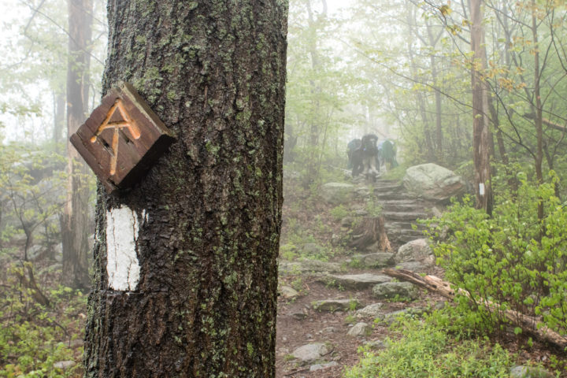
Undertake an Expedition
Appalachian Trail from Damascus, VA to Partnership Shelter, 62.2 miles.

Slide 92
Requirement 8
Go on an Expedition. Complete the following:
With your parent's permission and under the supervision of your merit badge counselor or a counselor-approved qualified person, use the planning steps you learned in requirement 6 and the preparations you completed in requirement 7 to personally undertake an actual expedition to an area you have not previously explored.
Discuss with your counselor what is outdoor ethics and its role in exploration and enjoying the outdoors responsibly.
After you return, compile a report on the results of your expedition and how you accomplished your objective(s). Include a statement of the objectives, note your findings and observations, include photos, note any discoveries, report any problems or adverse events, and have a conclusion (whether you reached your objective or not). The post-expedition report must be at least one page and no more than three; one page can be photos, graphs, or figures.

Slide 93
Outdoor Ethics
The Principles of Leave No Trace
Plan ahead and prepare. Consider your group’s size, age, and skill level. Gather information (geography, weather, regulations)about the place you will be visiting, and allow enough time to get there.
Travel and camp on durable surfaces. Follow and use established trails and campsites.
Dispose of waste properly. Pack it in, pack it out. Pack out all leftover food and trash. This may include human waste, toilet paper, and hygiene products. Keep water sources clean.
Leave what you find. Examine cultural or historic structures, artifacts, rocks, plants, and other natural objects – but leave them alone.

Slide 94
Outdoor Ethics
The Principles of Leave No Trace
Minimize campfire impacts. Use lightweight stoves for cooking and battery-operated lanterns instead of campfires. If fires are permitted, use established fire rings, keep the small, and put them out cold.
Respect wildlife. Enjoy wildlife during the right time of year, from afar, and never feed them. Store rations and trash securely.
Be considerate of other visitors. Respect their privacy and property, and allow them to enjoy the outdoors peacefully.

Slide 95
Outdoor Ethics
Tread Lightly! Principles
Travel responsibly. Stay on designated roads, trails, and areas. Cross streams and launch your watercraft only in designated areas.
Respect the rights of others. This includes private property owners, all recreational trail users, campers, and others.
Educate yourself. Plan for your trip by obtaining maps, regulations, and other information from public agencies. Know how to operate your equipment safely.
Avoid sensitive areas. Many of these areas, such as historical, archaeological, and paleontological sites, are also protected by law.
Do your part. Be a model user of the outdoors; leave the area better than you found it.

Slide 96
Outdoor Ethics
The Outdoor Code
As an American, I will do my best to – Be clean in my outdoor manners. Be careful with fire. Be considerate in the outdoors. Be conservation minded.

Slide 97
Requirement 8
Go on an Expedition. Complete the following:
With your parent's permission and under the supervision of your merit badge counselor or a counselor-approved qualified person, use the planning steps you learned in requirement 6 and the preparations you completed in requirement 7 to personally undertake an actual expedition to an area you have not previously explored.
Discuss with your counselor what is outdoor ethics and its role in exploration and enjoying the outdoors responsibly.
After you return, compile a report on the results of your expedition and how you accomplished your objective(s). Include a statement of the objectives, note your findings and observations, include photos, note any discoveries, report any problems or adverse events, and have a conclusion (whether you reached your objective or not). The post-expedition report must be at least one page and no more than three; one page can be photos, graphs, or figures.

Slide 98
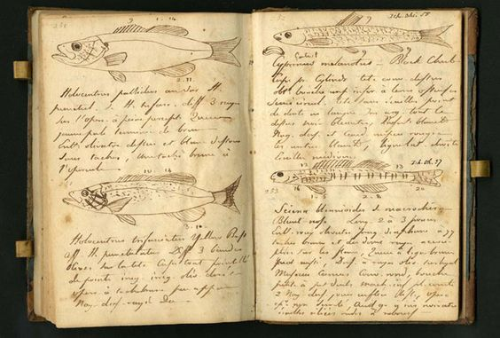
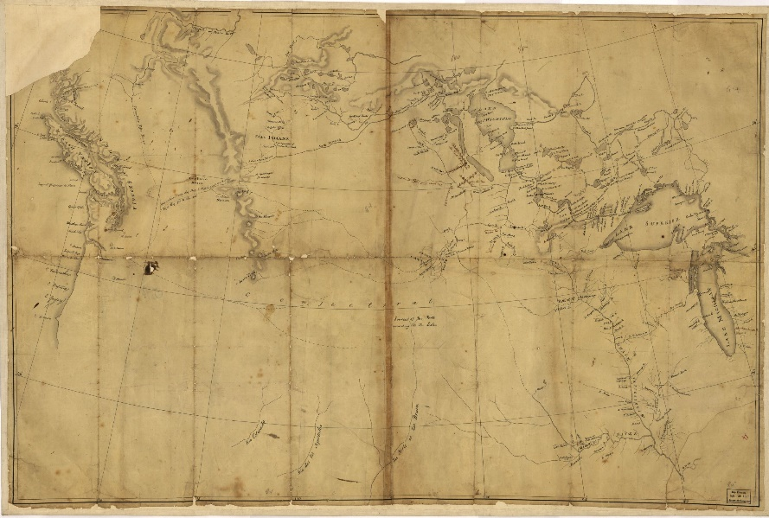
Expedition Report
Lewis and Clark Expedition Report

Slide 99
Requirement 9
Career Opportunities. Identify three career opportunities in exploration. Pick one and explain to your counselor how to prepare for such a career. Discuss what education and training are required, and why this profession might interest you.

Slide 100
Career Opportunities in Exploration
Writers or Authors
Writers and authors explore the world from the comfort of their own home or office, or they may travel to experience cultural practices or inspect significant sites related to their writing. They may perform extensive research on any topic and use what they learn to produce things like movie scripts, articles, or textbooks. Writers and authors usually hold a bachelor's degree.
Archeologists or Anthropologists
Anthropologists explore how people lived in the past or how cultures and languages developed. Archeologists locate and preserve historic artifacts. It's common for anthropologists and archeologists to travel as part of their work and interact with people from different parts of the world as they explore cultures, languages or search for historic sites. Archeologists and anthropologists must have a master's or doctoral degree to work in their fields.

Slide 101
Career Opportunities in Exploration
Medical Scientists
Medical scientists may never leave their laboratories to perform their work, but they provide critical information to healthcare professionals. They explore diseases and health treatments; their work involves research about how diseases originate, how they're spread and how to treat them. Whenever a new medication is being developed, medical scientists are on the front lines, exploring its effectiveness and safety. They are required to have a doctoral degree or a medical degree to work in this field.
Physicists or Astronomers
Through their research and studies, physicists and astronomers explore time and space and may learn about how the universe formed or how it's currently changing. They conduct experiments to test their theories; they may be involved in monitoring comets or asteroids, or working with electrons. Although it may be possible to obtain entry-level work as a physicist with a bachelor's degree, astronomers and physicists usually need to have a doctoral degree in their field.

Slide 102
Career Opportunities in Exploration
Photographers
Photographers capture images using cameras. Those that specialize in nature or wildlife photography, or that work as photojournalists, are more likely to travel extensively. Their travel introduces them to new species, habitats or information that they can document through photographs. Although formal training isn't always required, those that want to work as photojournalists typically need to have a degree, and those that are interested in photographing nature, wildlife or cultures may benefit from postsecondary training related to their area of interest.
Geoscientists
Geoscientists explore Earth; they perform tests on soil and rock samples as part of their studies. They may also be involved in developing maps. Some work to discover where oil may be located, while others study the history of the Earth's development. Geoscientists usually need a license; a master's degree may be preferred, although it may be possible to start out in this field with a bachelor's degree.

Slide 103
Career Opportunities in Exploration
Police or Detectives
Police and detectives are involved in exploration through the investigation of crimes; they study crime scenes, look for and test evidence, question witnesses and search for information that can help them solve a crime. Some law enforcement professionals also work as trained divers who locate evidence in a river, lake or ocean. Police academy training is required to work in this field, although additional training may be required for a position as a diver, and some law enforcement agencies require officers to have a degree.

